Slide 1
3rd Annual International Tax Student Case Competition
August 14–16, 2025 | Montreal, Canada
Presented by: Tax Executives Institute (TEI)

Slide 2
Agenda
About TEI
Welcome Participating Universities
Competition Overview
Event Schedule
Team Composition & Mentorship
Travel and Accommodations
What's Next
Contact & Further Information
Q&A
1

Slide 3
About TEI
Tax Executives Institute (TEI) is a member-based organization dedicated to the professional needs of the in-house tax community worldwide.
Mission: Educate, network, and advocate on all aspects of business taxation.
Global Presence: Chapters and members across North America and internationally.
2

Slide 4
Welcome Participating Universities
3

Slide 5
Competition Overview
Purpose: To support students in developing a passion for taxation through real-world case analysis.
Format: Teams of four students tackle an international tax case and present solutions to a panel of judges.
Network: Connect with other students & mentors from all over the world!
Prize: CAD $2,000 awarded by IFA Canada to the 1st place team for Best Overall Presentation and Team Effort.
4

Slide 6
Event Schedule
Thursday, August 14, 2025
4:00 PM – 7:00 PM: Foosball Tournament at Andersen Canada
Friday, August 15, 2025
8:00 AM – 1:00 PM: AI & Technology in Tax Seminar and Workshop
3:00 PM – 4:30 PM: Walking Tour
5:00 PM – 7:00 PM: Cocktail Reception at Gowling WLG Offices
7:00 PM – 9:00 PM: Dinner With Your Team
Saturday, August 16, 2025
8:00 AM – 5:00 PM: Case Competition (includes breakfast and lunch)
6:00 PM – 7:00 PM: Cocktail Event
7:00 PM – 10:00 PM: Gala and Awards Ceremony at St. James Club
10:00 PM – Afterparty / Montreal Night Life
5

Slide 7
Team Composition & Mentorship
One team of four students per university.
Each team paired with two TEI-assigned mentors.
Orientation and basic training kicks off in May 2025.
Team meetings with mentors from June to Aug 2025.
Teams receive access to training material in June
6

Slide 8
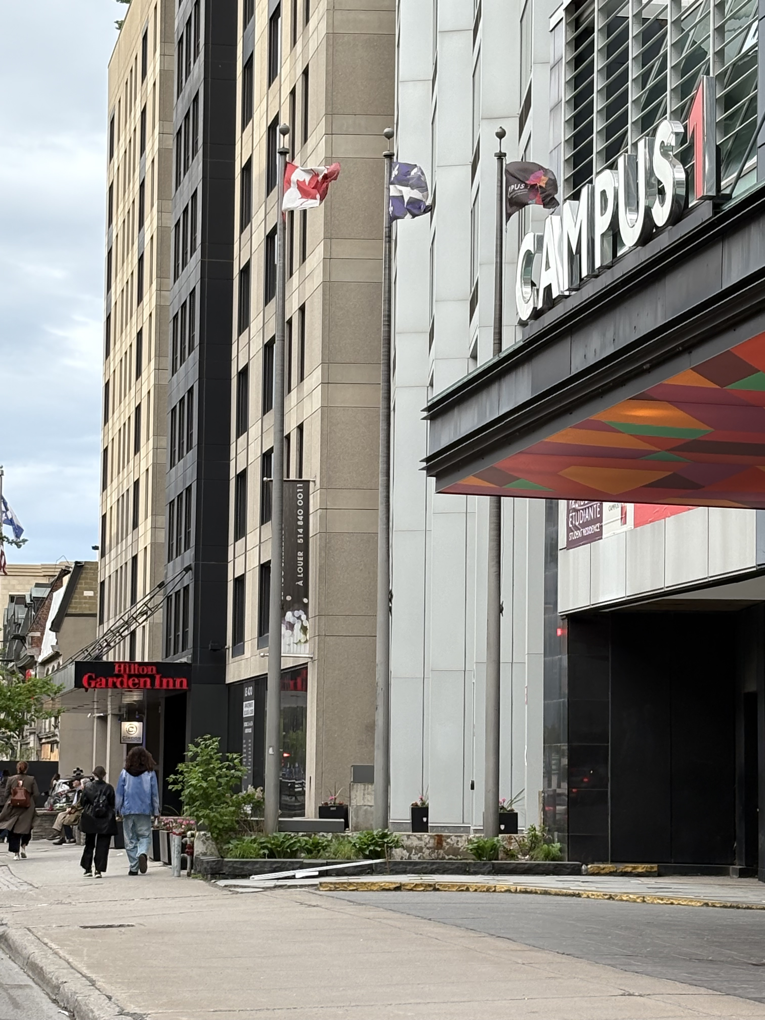
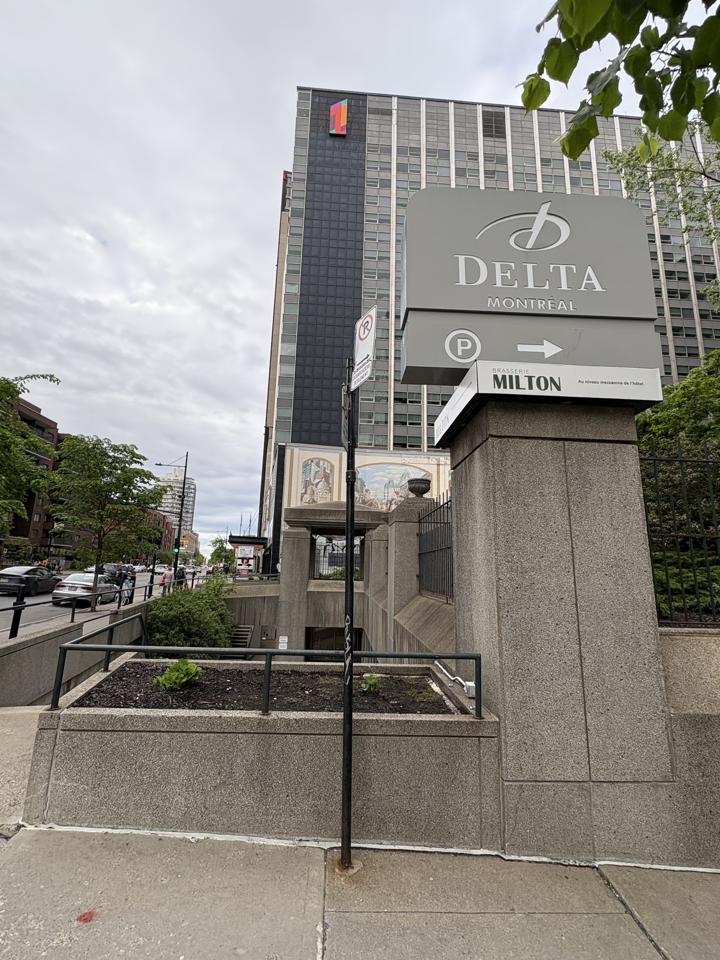
Travel & Accommodations
Travel:
Book your flights now!
Recommended Airport: Montréal–Trudeau International Airport (YUL)
Visa Reminder (If you require a letter of support, feel free to contact us)
Make sure passports are valid
Hotel Accommodations:
Check in Thursday, Aug 14 & Check out Sunday, Aug 17 (3 nights)
Recommended for Students:
Campus 1 MTL Student Residence (420 Sherbrooke Street West, H3A 1B2 Montreal, Canada)
Recommended for Mentors:
Hilton Garden Inn Montreal Centre-Ville (380 Sherbrooke St W, Montreal, Quebec H3A 0B1)
Delta Hotel by Marriott (475 President-Kennedy Avenue Montreal, Quebec, Canada, H3A 1J7)
7

Slide 9
What's Next
Travel & Accommodations:
Book now!
Information Platform:
Access coming soon
Mentor Assignment
Early June
Study Materials
Week of June 9
Upcoming Housekeeping Calls - Save the Date
June 12, July 10
8

Slide 10
Contact & Further Information
Main Contact:
Jentry Whitehurst – youngtaxnetwork@tei.org
Social Media:
Instagram: @taxexecutivesinstitute
LinkedIn: Tax Executives Institute
9

Slide 11
Q&A
Questions & Answers
Thank You!
10

